Slide 1
Getting started with Mu Argus
SURS

Slide 2
Input files for Mu Argus

Slide 3
Basic terms in Mu Argus Variable types
HH Identifier: The unique identifier of a household
HH Variable: A variable that by its nature has the same value for each member of a household
Weight: The variable is a sampling weight
Categorical: Can be defined as a quasi-identifier
Numerical: A numerical variable can be used for top/bottom coding, microaggregation and rounding
A variable can be both numerical and categorical (=ordinal)

Slide 4
Basic terms in Mu-Argus
The weight for local suppression, default value is 50. A higher value means less possibility for suppression.
The name of a codelist file is optional (it is only used when displaying information on this variable).
It is also possible to specify the truncation if it is a feasible way of recoding (special case of hierarchical variable)
At least one missing value has to be specified for each categorical variable. Missing values play a specific role in the SDC-process, as missing values will be imputed when local suppression is applied.
The weight variable cannot have a missing value.

Slide 5
Truncation
In case of hierarchical structure of variable‘s codes
Certain number of characters is chopped from the end of variable‘s values
Example:
A10.100 (NACE)
4 characters are chopped from NACE
Result: A10

Slide 6
Input files with microdata
Only the variables that are the quasi-identifiers need to be in the input file for Mu-Argus.
Statistical identifier should be also included in the input file, after protection all non-confidential variables are added (link is statistical identifier).
Members of the same households must be grouped together (sorted by the household identifier).
Sampling weights must not have missing values.
Structure
a fixed format ASCII file (.asc)
free format file with a specified separator (.csv) with or without variable names
SPSS format

Slide 7
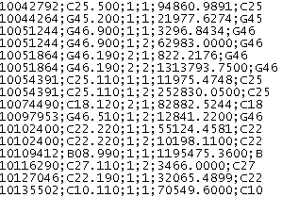
Microdata file (.csv)
Delimited file with or without variable names in the first row

Slide 8
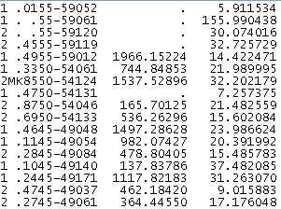
Microdata file (.asc)
Variables have fixed length

Slide 9
Structure of ASCII file
Right-aligned variables
No variable names in the first row
Missing values are allowed
All values for each numerical variable have to have the same number of decimal places

Slide 10
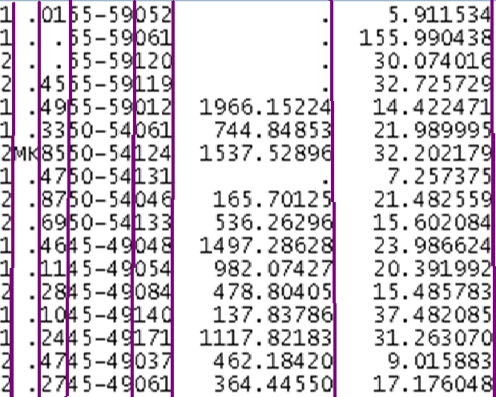
Structure of ASCII file
gender – 1 place
citizenship – 2 places
activity (NACE) – 2 places
age classes– 5 places
municipality – 3 places
income – 12 places, 5 decimal places
weight - 12 places, 5 decimal places
Decimal point is 1 place long!

Slide 11
Metadata file (.rda)
The description of input data file (structure of .asc or .csv)
Includes metadata about variables
Identification level
Missing values
Length + number of decimals
Type of variable (response, household identifier, explanatory, weight; numerical/categorical, etc.)
Links between variables are specified (the same suppression pattern).
Differs due to the type of input file (.asc or .csv)
It can be created in Mu Argus.

Slide 12
Metadata file (.rda)
METADATA FILE | MEANING
<RECODABLE> | This variable may be recoded.
<CODELIST> | Name of the codelist file
<IDLEVEL> | Identification level
<TRUNCABLE> | Relevant way of recoding (e.g. NACE)
<NUMERIC> | The variable is numeric.
<DECIMALS> | The number of decimal positions for a (numeric) variable
<WEIGHT> | The variable contains sample weights.

Slide 13
Metadata file (.rda)
METADATA FILE | MEANING
<HOUSE_ID> | This variable is a household identification.
<HOUSEHOLD> | A household variable typically contains the same value for each member of a household. When the suppression of the value for one member is necessary, it will be done for all members.
<SUPPRESSWEIGHT> | Priority weight for the selection of the suppression pattern; default value = 50

Slide 14
Metadata file for .asc file
REGION 1 4 9999 9998
<RECODABLE>
<CODELIST> "regio.cdl"
<IDLEVEL> 1
<SUPPRESSWEIGHT> 50
<TRUNCABLE>
SEX 5 1 9
<RECODABLE>
<CODELIST> "Sex.cdl"
<IDLEVEL> 2
<SUPPRESSWEIGHT> 50
MARSTAT 8 1 9
<RECODABLE>
<IDLEVEL> 3
<SUPPRESSWEIGHT> 50
Variable‘s length
Missing value
Starting place

Slide 15

File for global recoding (.grc)
Categorical variable
We can write it in Mu-Argus and save it as .grc file or we can import .grc file.
Structure:
on the left new value, after the colon recoded values:

Slide 16
Codelist file (.cdl)
Each categorical variable can have a code list.
Code lists are used only in Mu Argus.
1,Dutch
2,North-Europe
3,South-Europe
4,North-America
5,South-America
6,Mediterrenean
7,African
8,Asian
9,Unknown

Slide 17
Introduction to Mu Argus

Slide 18
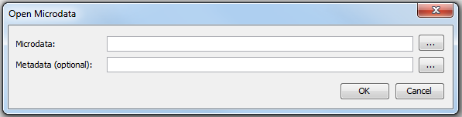
File | Open Microdata
The menu for choosing the microdata (.asc,.csv) and optionally the metadata file („.rda“)

Slide 19
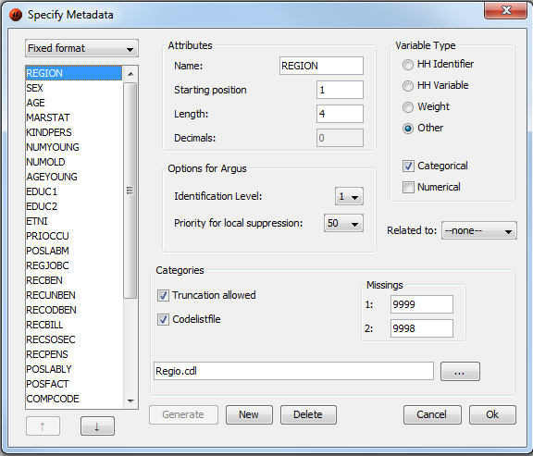
Specify | Metafile
Construction / Change of metadata file (.rda)
Variable properties:
Length, starting position, missing values, codelists, identification level, etc.
Related to …

Slide 20
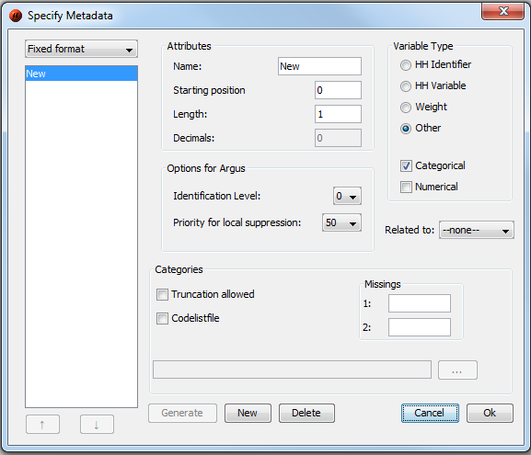
Specify | Metafile
In case of no „.rda“ file, click button „New“ to enter variables‘ metadata.
Fixed format – „.asc“, Free format – „.csv“, Free format with meta – „.csv“ with variables‘ names in the first row.

Slide 21
Identification levels
0: an individual cannot be identified by this variable and it will not play a role in the
disclosure control process.
1: the variable is most identifying (E)
2: the variable is more identifying (V)
3: the variable is identifying (I)

Slide 22
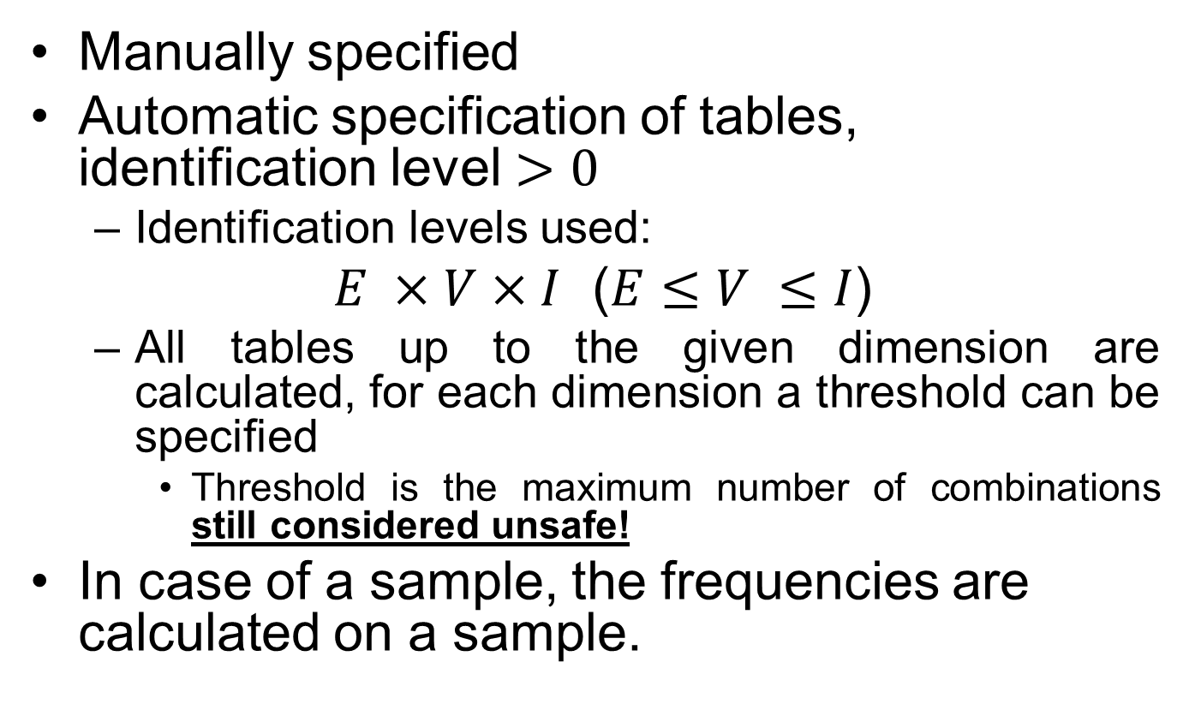
Specify | Combinations
Manually specified
Automatic specification of tables, identification level $>0$
Identification levels used:
$E ×V×I$ ($E≤V ≤I$)
All tables up to the given dimension are calculated, for each dimension a threshold can be specified
Threshold is the maximum number of combinations still considered unsafe!
In case of a sample, the frequencies are calculated on a sample.

Slide 23
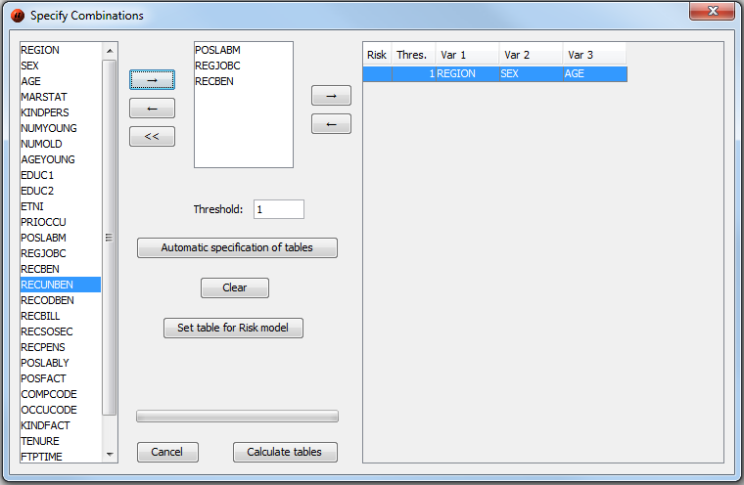
Specify | Combinations
Three options:
Specified manually
Automatic specification of tables
Identification levels
Up to given dimension
Special combination can be selected for risk estimation
Click Calculate tables.

Slide 24
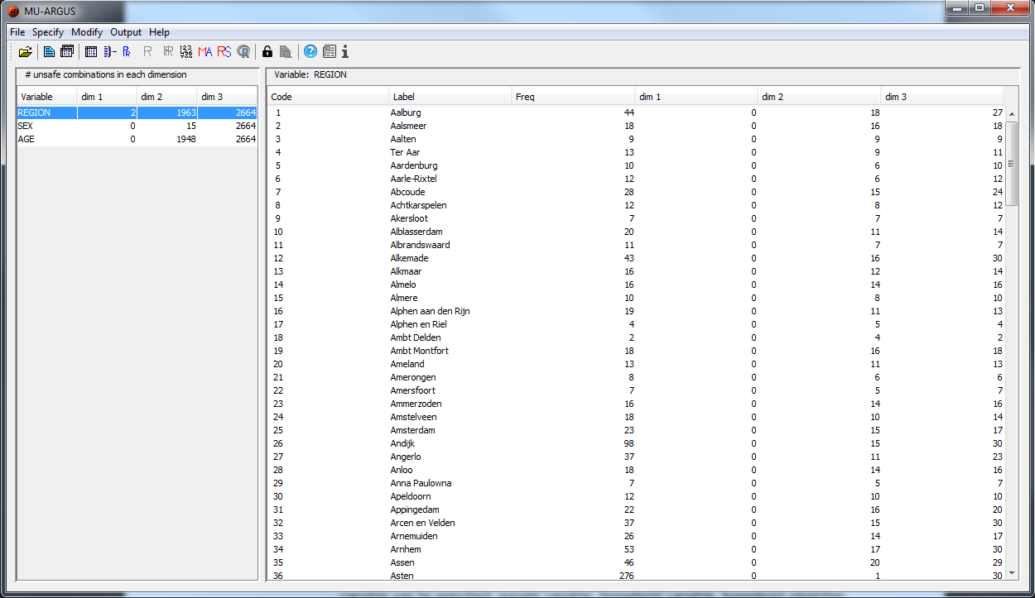
Number of unsafe combinations for each dimension/variable.
If n-dimensional combination is checked, then all
i-dimensional combinations are also checked, i = 1…n-1!

Slide 25
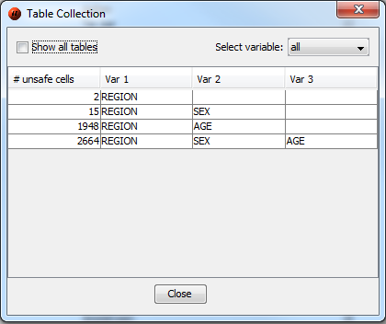
Modify | Show Table Collection
Select variable – tables with just chosen variable

Slide 26
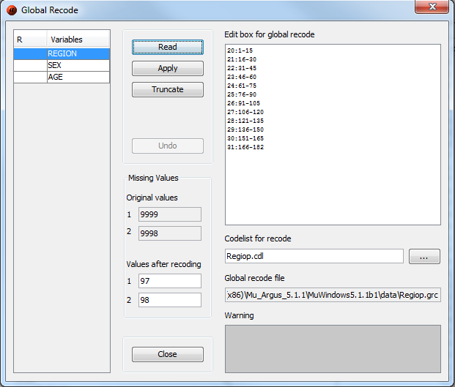
Modify | Global recode
Read – import of „.grc“ file
OR
Write it manually
Don‘t forget to click Apply!

Slide 27
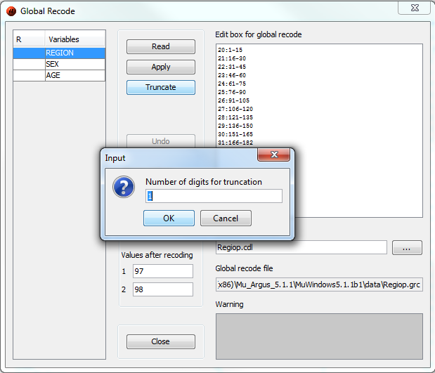
Modify | Global recode
Truncate
Specify the number of characters
x characters are chopped from the end of variable‘s values (special case of hierarchical variable)
Always applied to the original values (if you want to truncate the same variable twice, each time one digit, you have to fill in “2” the second time)

Slide 28
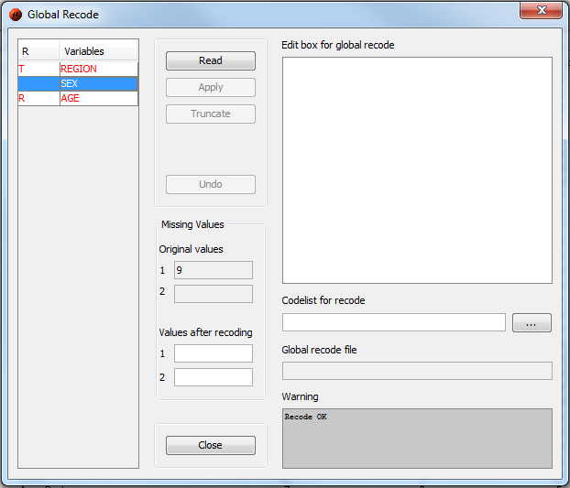
Modify | Global recode
If you apply a global recoding or truncate a variable, the colour of the variable will be changed into red and an ‘R’ or a ‘T‘ will be indicated in the first column of the list-window.

Slide 29
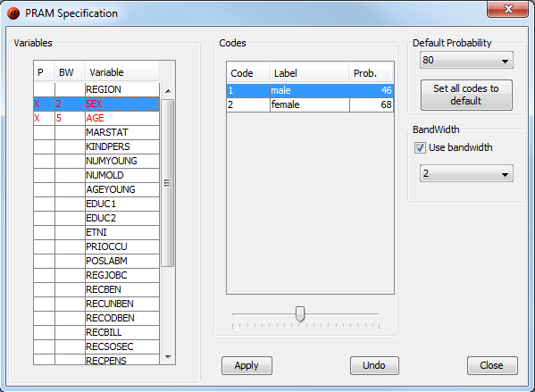
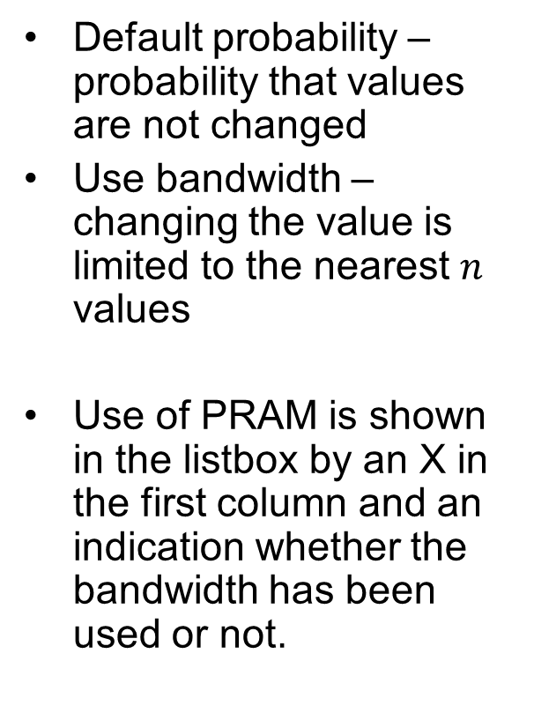
Modify | PRAM specification
Default probability – probability that values are not changed
Use bandwidth – changing the value is limited to the nearest $n$ values
Use of PRAM is shown in the listbox by an X in the first column and an indication whether the bandwidth has been used or not.

Slide 30
Modify | Modify numerical variables
Top/Bottom coding
Rounding
Add noise to the weight variable

Slide 31
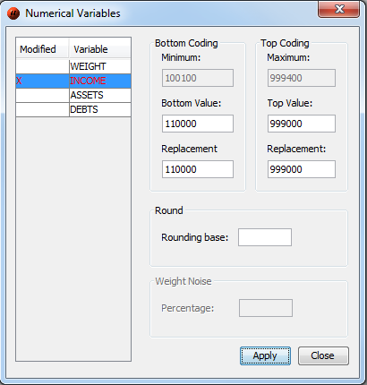
Modify | Modify numerical variables | Top/Bottom coding
Actual top and bottom value for variable INCOME.
Values below/over these thresholds are replaced. Click Apply.
Use of the method is shown in the listbox by an X.

Slide 32
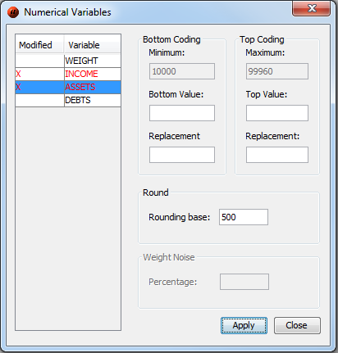
Modify | Modify numerical variables | Round
Actual top and bottom value for variable ASSETS.
Rounding base. Click Apply.
Use of the method is shown in the listbox by an X.

Slide 33
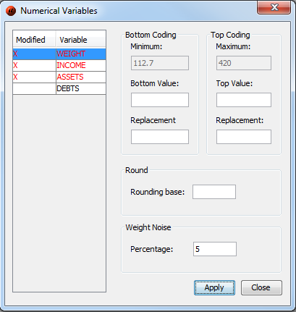
Modify | Modify numerical variables | WeightNoise
Actual top and bottom value for variable WEIGHT.
Percent of the weight noise. Click Apply.
Use of the method is shown in the listbox by an X.

Slide 34
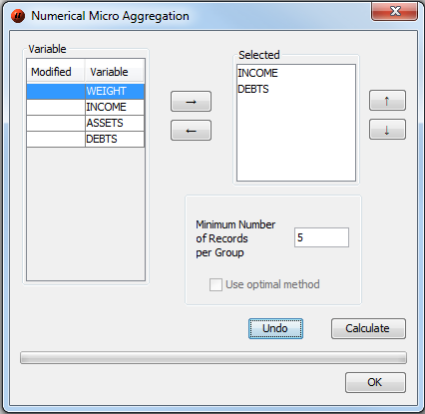
Modify | Numerical Micro Aggregation
Selected variables will be „microaggregated“.
Minimum number of records per group.
Use of optimal method possible only for a single variable and a small microdata set.

Slide 35
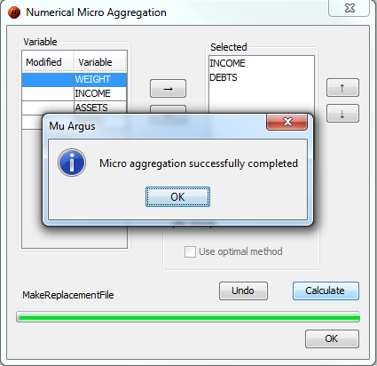
Modify | Numerical MicroAggregation
Click Calculate → OK → OK.

Slide 36
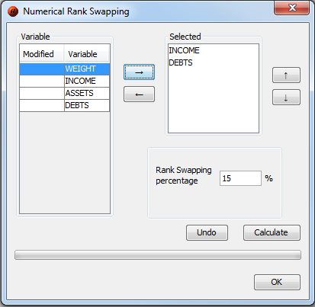
Modify | Numerical Rank Swapping
The rank swapping will be applied on selected variables.
Percentage for rank swapping.
The procedure is applied on each variable individually.

Slide 37
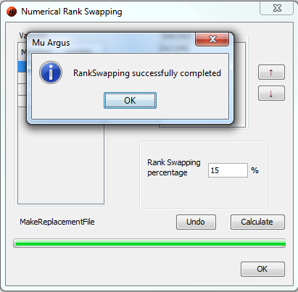
Modify | Numerical Rank Swapping
Click Calculate → OK → OK.

Slide 38
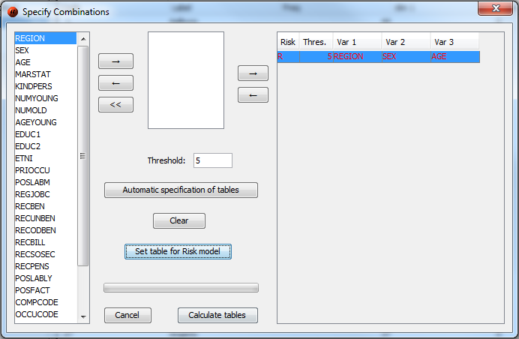
Specify | Combinations
Risk estimation:
Combination(s) of variables can be selected.
Click Set table for Risk model (R).
Click Calculate tables.
Overlapping risk tables are not allowed.

Slide 39
Modify | … Risk Specification
No perturbation methods should be used.
If household id present in microdata → Modify | Household Risk Specification
If NO household id present in microdata → Modify | Individual Risk Specification

Slide 40
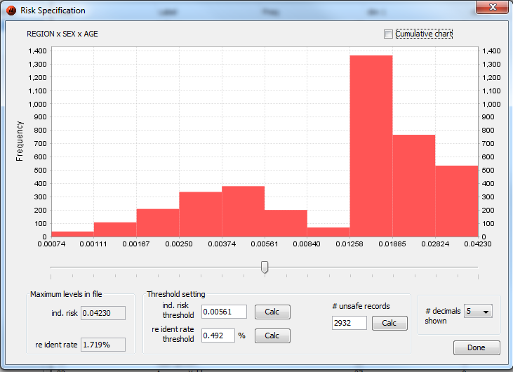
Modify | Individual Risk Specification
Maximum levels in file:
Inv. risk (max)
Re ident rate (expected re-identifications)
Threshold setting:
Slider
Write a threshold in the „ind. risk threshold“ text box.

Slide 41
Modify | Individual Risk Specification
Threshold setting:
Inv. Risk threshold ≤ Inv. Risk (max)
Re ident rate threshold ≤ Re ident rate
Number of unsafe records
Pressing „Done“ sets the ind. risk threshold → used for local suppression.

Slide 42
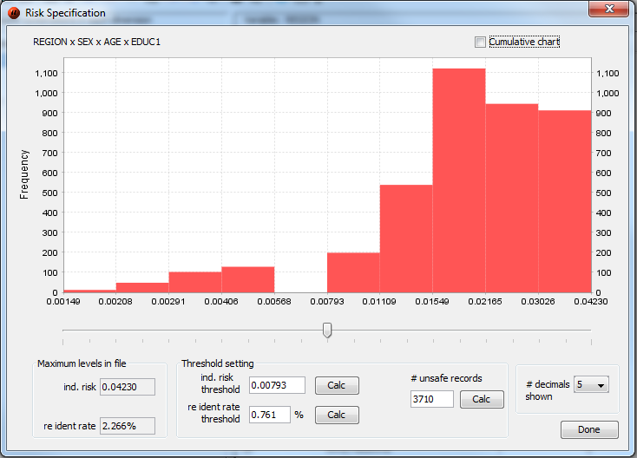
Example – before global recode

Slide 43
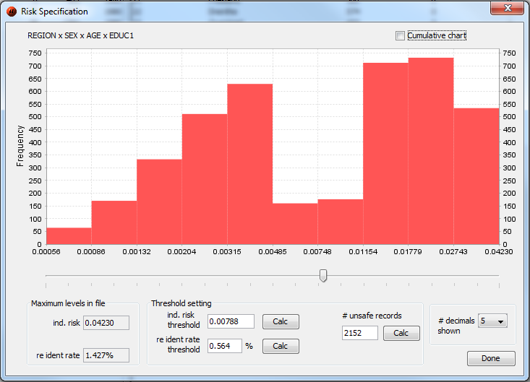
Example - after global recode

Slide 44
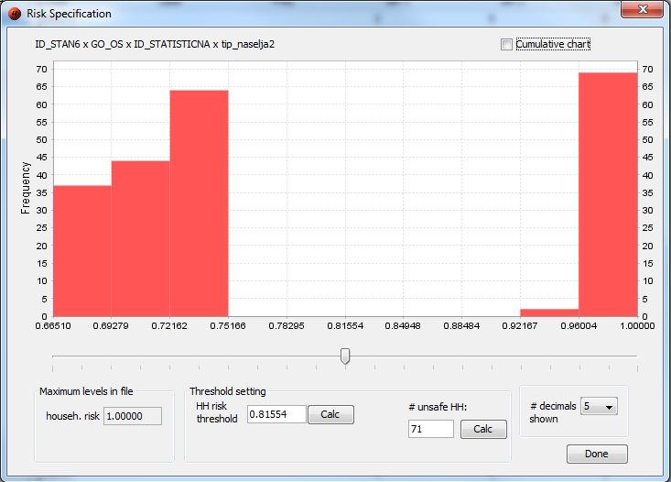
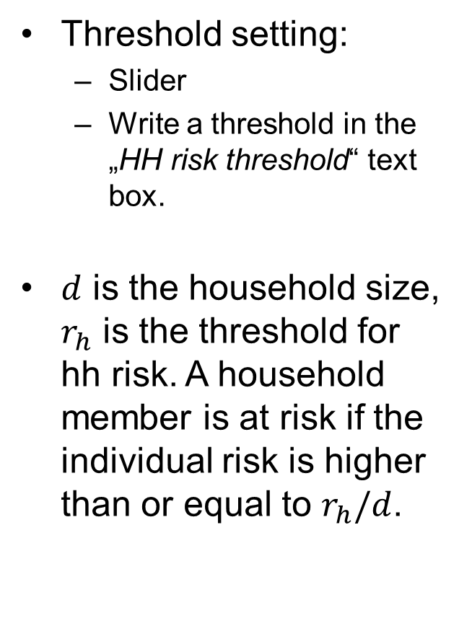
Modify | Household Risk Specification
Threshold setting:
Slider
Write a threshold in the „HH risk threshold“ text box.
$d$ is the household size, $r_{h}$ is the threshold for hh risk. A household member is at risk if the individual risk is higher than or equal to $r_{h}/d$.

Slide 45
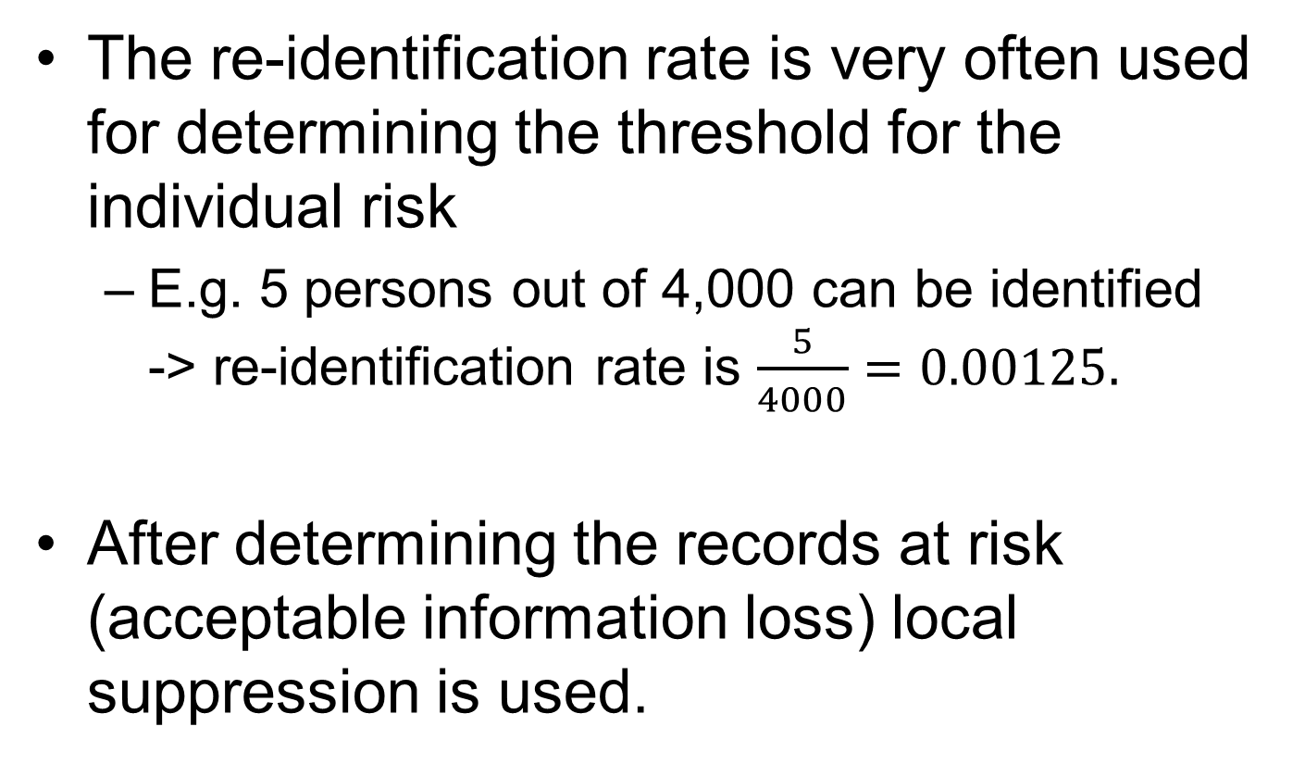
Modify | … Risk Specification
The re-identification rate is very often used for determining the threshold for the individual risk
E.g. 5 persons out of 4,000 can be identified -> re-identification rate is $\frac{5}{4000}=0.00125.$
After determining the records at risk (acceptable information loss) local suppression is used.

Slide 46
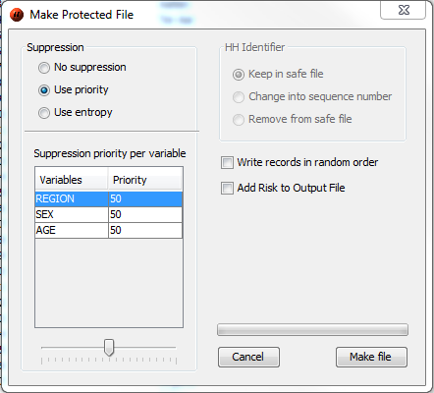
Output | Make protected file
Local suppression for unsafe combinations
Use priority (higher value means smaller information loss) – slider!
Use entropy (the variable with the highest number of small categories is suppressed)
In case of more unsafe combinations for one record, information loss is minimized.

Slide 47
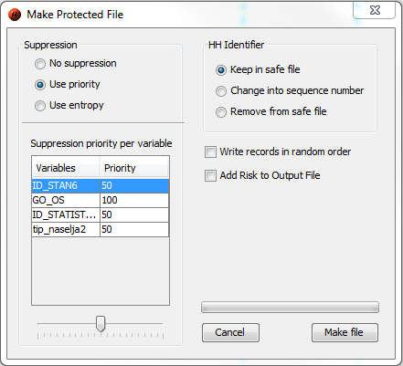
Output | Make protected file
Household identifier:
Do not change.
Change it into a simple sequence number.
Remove it from the dataset.

Slide 48
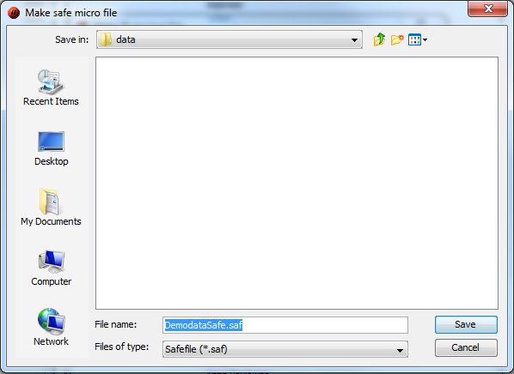
Output | Make protected file
Click Make file -> Choose location for the safe dataset (.saf)

Slide 49
Output | Make protected file
Two files are created:
Metadata file of the safe file (.rds)
Safe file (.saf)
The structure is the same as for input files

Slide 50
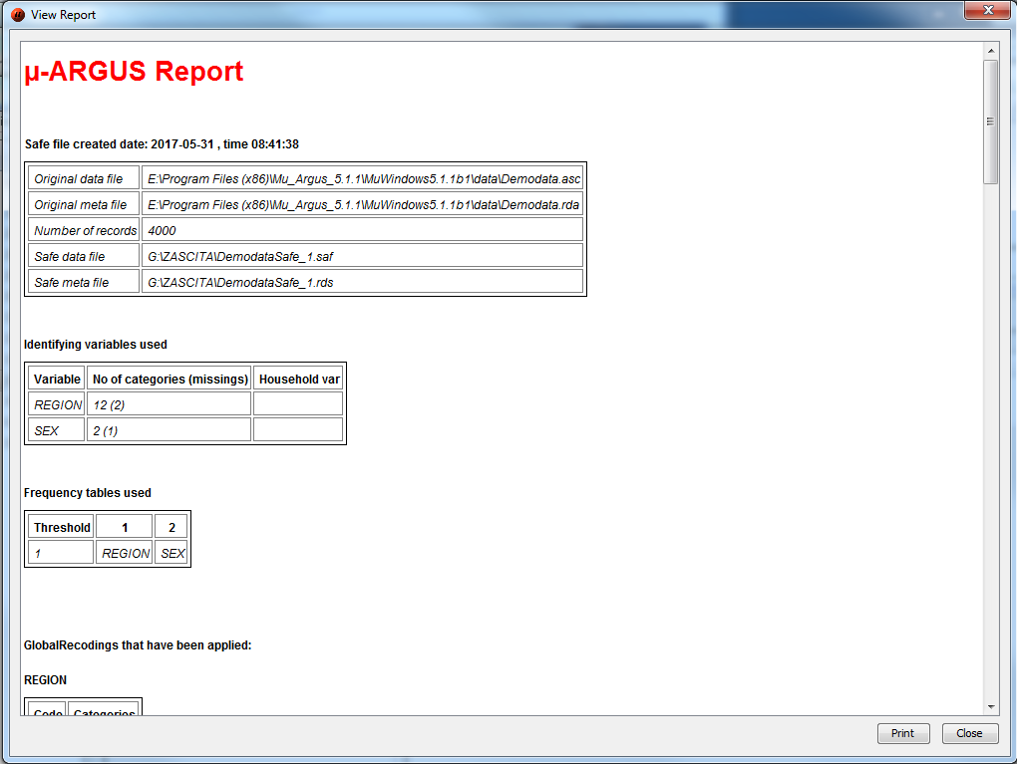
Output | View report

